Slide 1
Junior CCC Prep – J1
By Hussain M

Slide 2
What We Will Learn
Declaring integer variables
Inputting using scanner
Math operations in code
Using If statements

Slide 3
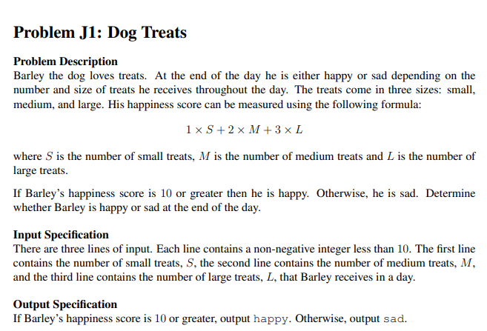
Example J1 Problem: Dog Treats

Slide 4
Break It Down To Smaller Problems

Slide 5
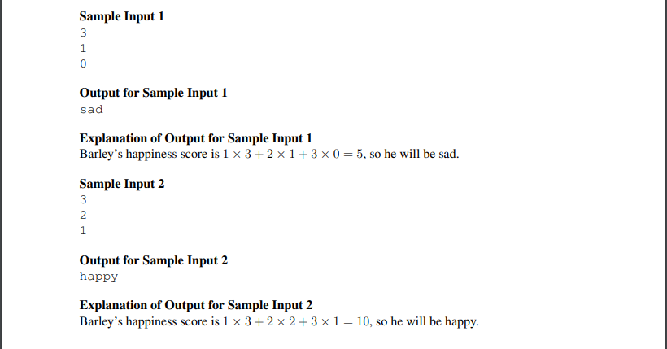
Sub-Problems
Input the data
What type of data is it?
How do we store this type of data?
Calculate happiness score
What is the formula to do this?
How do we represent this in code?
Output happy or sad
When do we output happy?

Slide 6
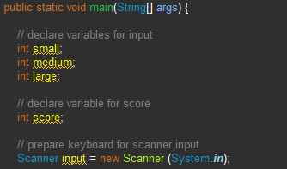
1) Input the data
Declare variables for…
Small treats
Medium treats
Large treats
Score
All variables are integers
Setup input using Scanner
Don’t forget to import java.util

Slide 7
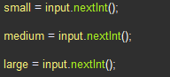
1) Input the data (continued)
c) Store input into variables
No need for prompt such as
“How many small treats are there?”
*Remember So in this case, small = 3, medium = 1, and large = 0

Slide 8

2) Calculate happiness score
Formula:
Input result into score variable

Slide 9
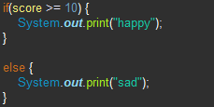
3) Output happy or sad
*Remember:
Use an if statement to determine whether to output happy or sad

Slide 10
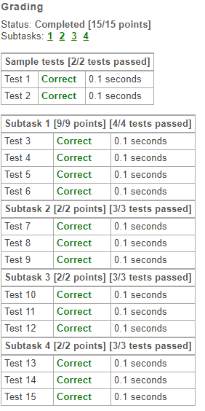
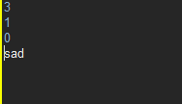
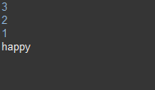
Test your solution

Slide 11
